Slide 1
Exploring Inefficiencies in NHL Betting Markets Through the Use of Machine Learning Techniques
Written By: Gus Weyand

Slide 2
Research Question
Is it possible to expose further inefficiencies in the NHL betting market through the use of advanced data and machine learning techniques?

Slide 3
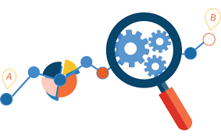
Purpose
Build on previous research regarding exposing inefficiency in the NHL betting market
Achieve Greater than 8.5% ROI by betting on about 10% of contests

Slide 4
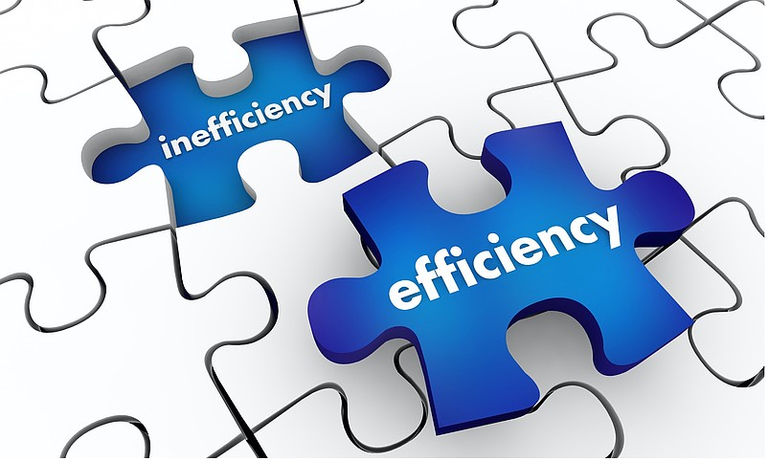
Defining Inefficiency
Market inefficiency in sports betting occurs when odds do not fully reflect the true probabilities of outcomes
If a model using only publicly available data can consistently generate positive returns, it indicates that the market is not fully efficient
Due to “holds”, negative returns of between 2.5-10% should be expected for random bets
(Kohers et al., 2021);(Luxton, Spizman, & Moore, 2022);(Ramsey, 2025)
Notes:
Economically inefficient markets are those that do not use all available resources - This means that the market is not fully utilizing all available information to determine fair prices.

Slide 5
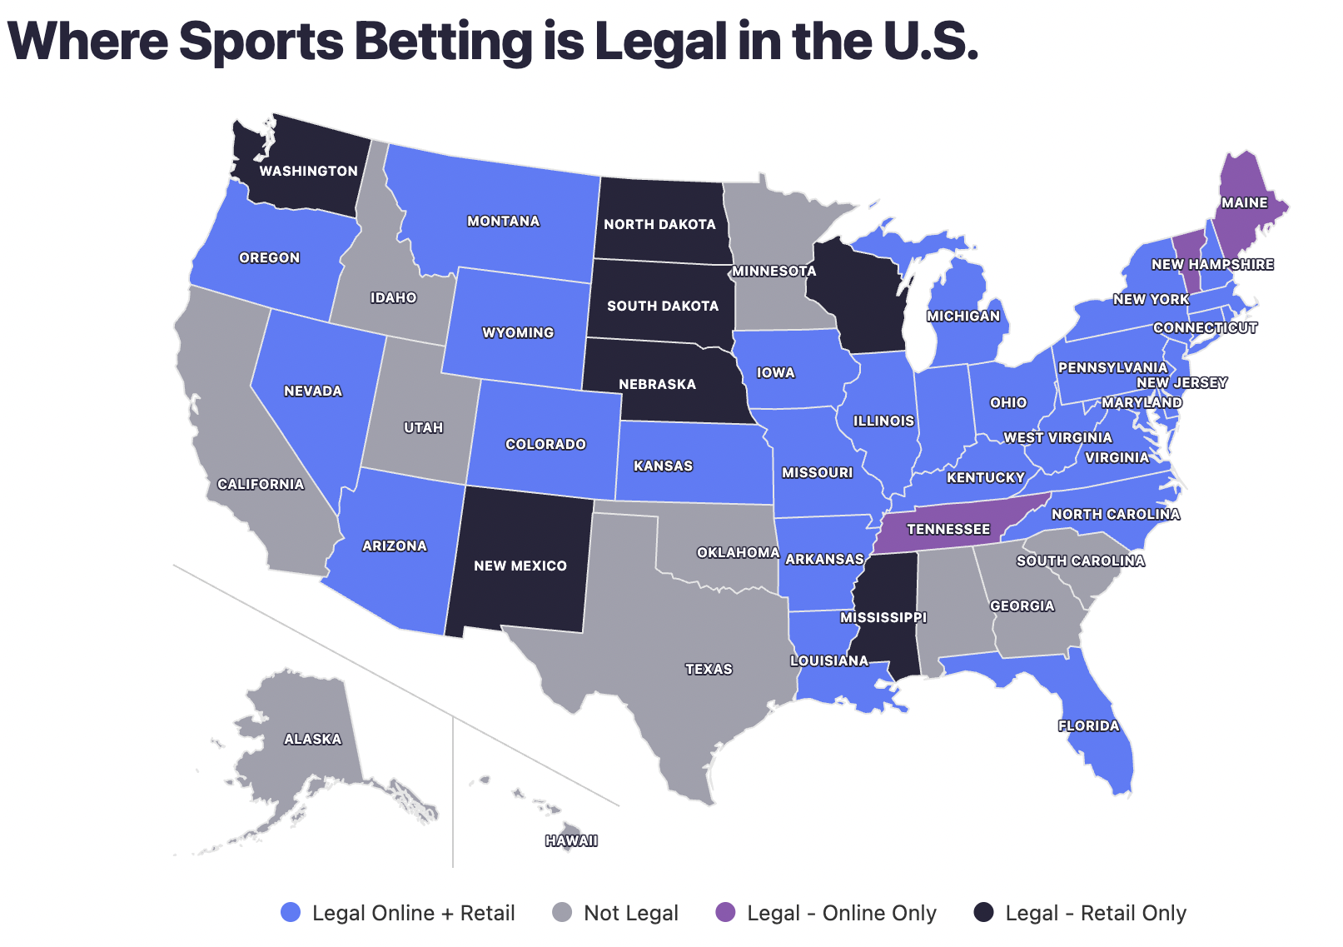
Background - Industry Growth
New legal status has led to widespread adoption of sports betting since 2018, now legal in 39 states
Industry has grown from 500 Million dollars in 2018 to 14.3 Billion today
17% of all gamblers have placed bets on NHL games
(RG, 2025); (RubinBrown, 2019)
Notes:
In 2018 the professional ana amauter sports protection act, which previously outlawed sports gambling.

Slide 6
Background - Bias in Gambling
“In-group” bias can lead to poor prediction accuracy
Hunch-based theories or personal interpretation can cloud judgement despite quantitative factors pointing to a different outcome
Prediction Type | Prediction Accuracy (%) | Actual Accuracy (%) | Difference (%)
Favorite Team Win | 74 | 38.7 | 35.3
Opponent Win | 11 | 30.3 | -19.1
Draw | 15 | 31.2 | -16.2
(Na et al., 2018)

Slide 7
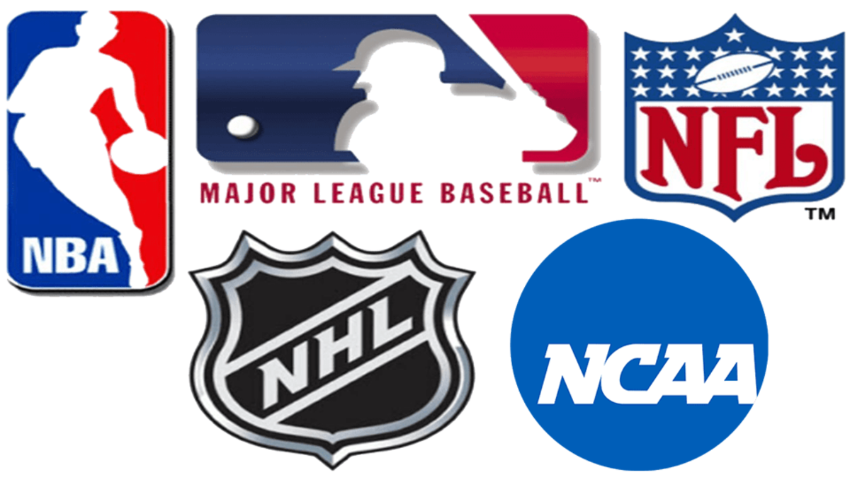
Previous Research
Inefficiency reviews have been conducted in the NFL, NHL, NCAAF, and more
Previous research suggests non-linear models having the greatest ability to find inefficiency
Model selection must also consider the amount of information available
(Luxton, Spizman, & Moore, 2022);(Oswald, 2022);(Remander, 2020)
Notes:
The use of AI or deep learning models require VAST amounts of information that simply might not be available. In research those models that model more complex relationships typically do better.

Slide 8
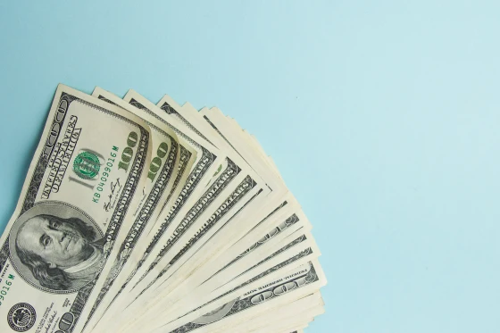
Previously Identified Inefficiencies - NHL
Favorite-longshot bias inefficiency
Greater than 50% accuracy found when using complex datasets and generalized linear models
2-way moneyline inefficiency
8.5% ROI when bets placed on most probable outcomes, approximately 8% of total games
(Luxton, Spizman, & Moore, 2022);(Oswald, 2022)
Notes:
Favorite longshot inefficiency refers to if a team is favored to win by a lot, a line will typically be set lower than the actual expected winning percentage. THis has the effect of giving underdogs better odds for winning or covering, which is beneficial due to the good odds that they have, room for profit.

Slide 9
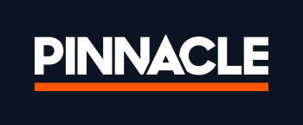
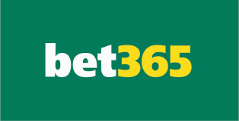
Data Collection
Data was collected from MoneyPuck.com - included over 100 predictions about each NHL game since 2008
Odds were collected OddsPortal, which averages 3-way moneyline odds from 6 major sportsbook, including Pinnacle and bet365

Slide 10
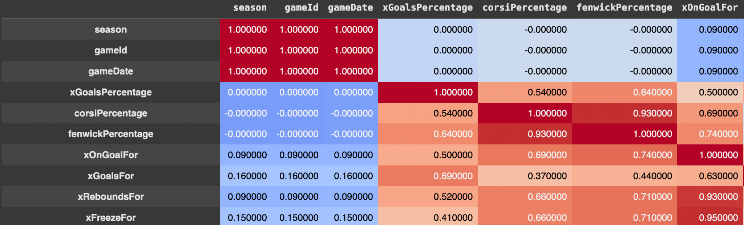
Data Cleaning
Several variables were deleted due to having significant collinearity
Others were removed due to having little perceived impact on outcomes
Numeric predictors were formed into a 3-week moving average
Principal Component Analysis (PCA) was performed on remaining variables, keeping 80% of overall variation in data with 18 PCA variables

Slide 11
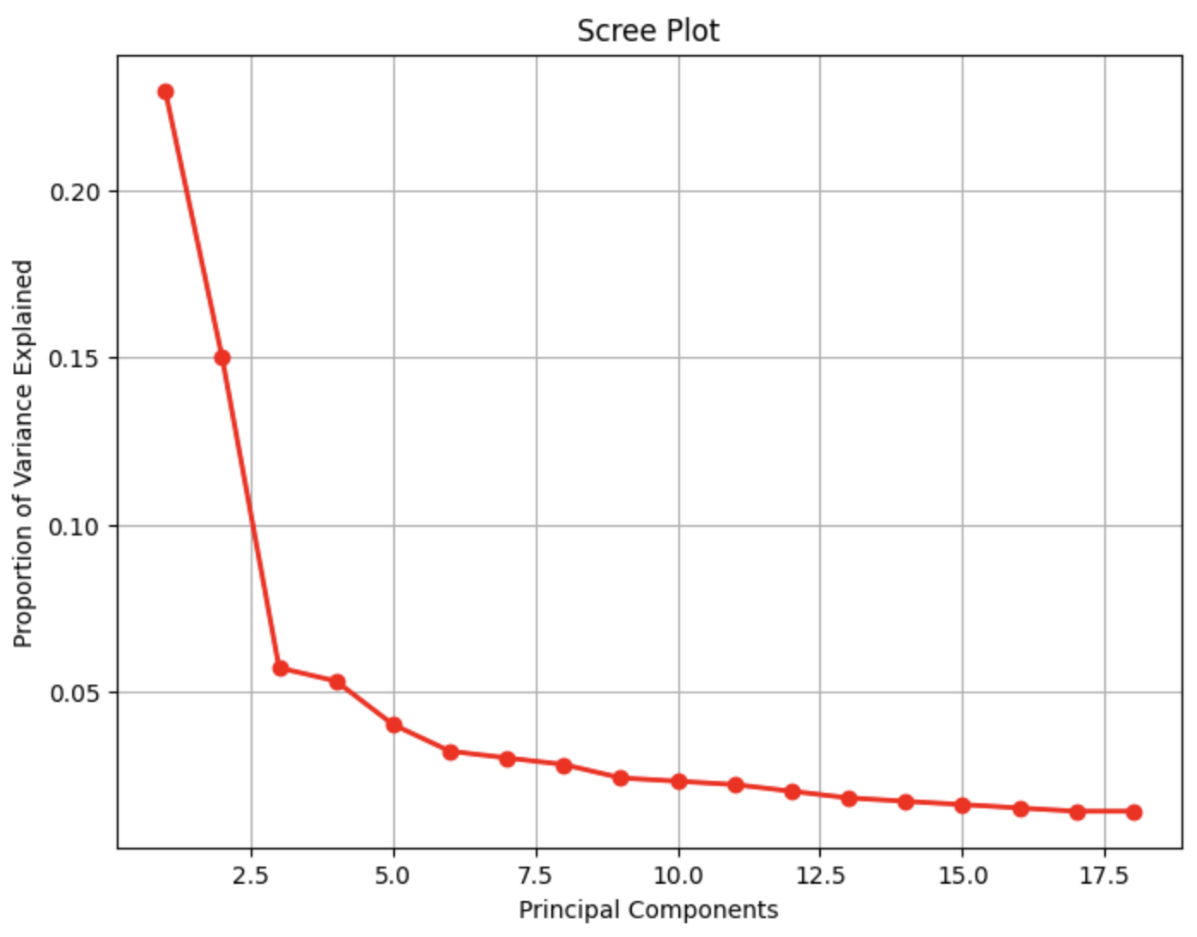
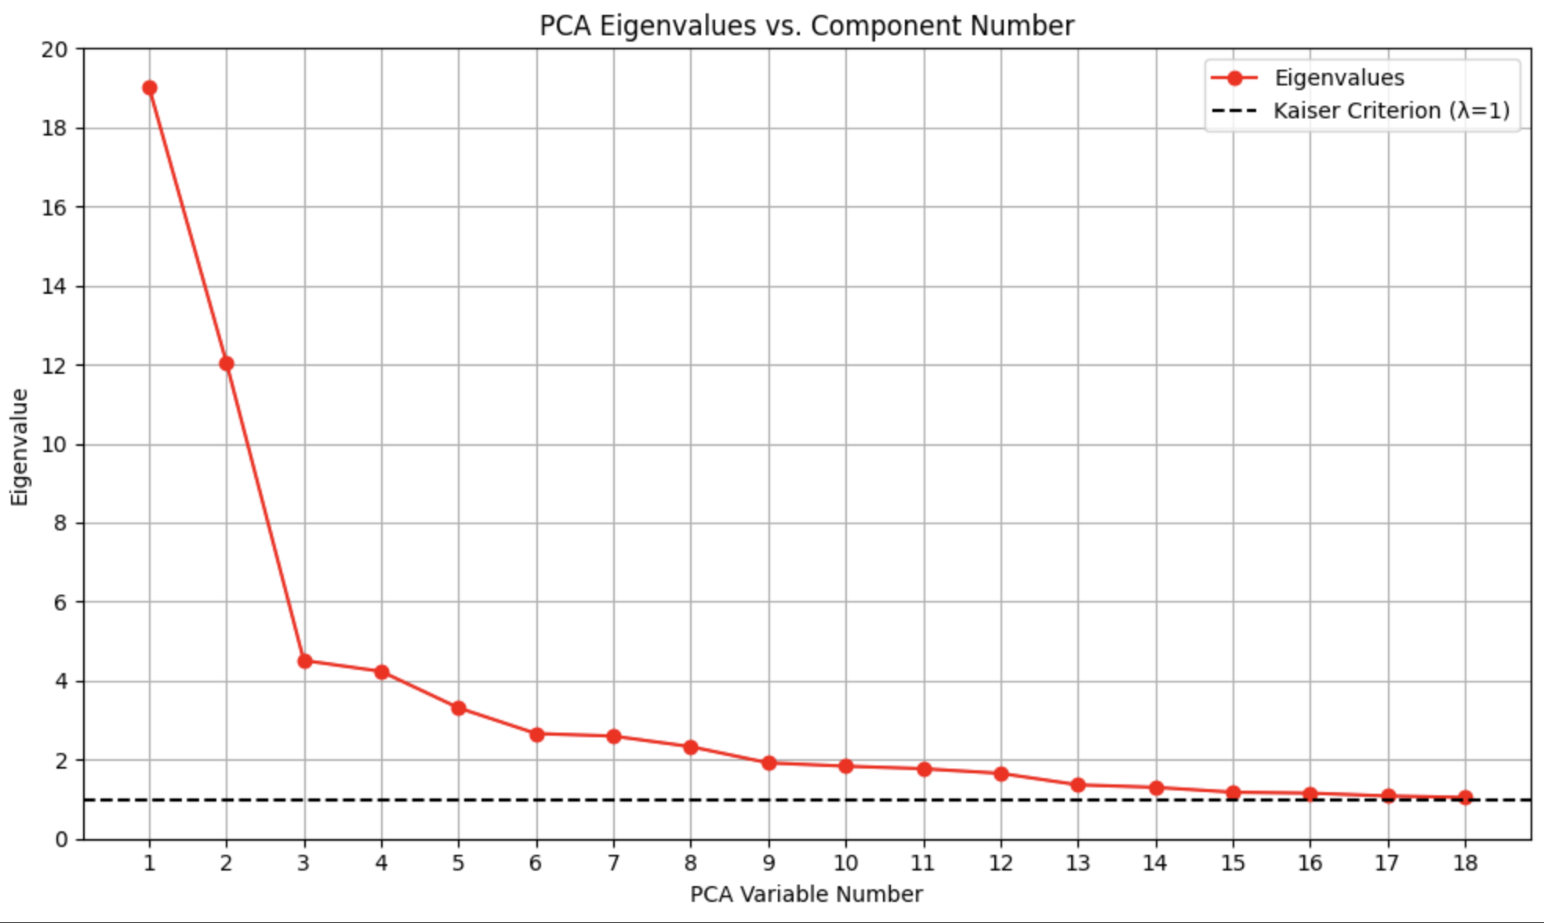
PCA - Variable Analysis

Slide 12
Significant Variables In PCA
Number of high-danger goals allowed
Number of takeaways made
Whether the game is played at home or away
Number of high-danger shots allowed
Number of hits made
Number of low-danger goals scored
Total shot attempts allowed
Number of goals scored on rebounds
Number of giveaways made
Total goals scored in the last 3 games
Notes:
Need to mention that when PCA’s are used in the model, there is loss of interpretation, but these are some factors that the model will be making decision upon

Slide 13
Modeling
3 tree-based machine learning models were developed to find inefficiencies
Tree based models are advanced at modeling non-linear relationships
Many decision trees are created, these trees then vote on each game as a win or a loss depending on the result in that tree
If more trees vote for a win than a loss, the prediction is a win
The proportion of trees that vote for a win is known as a propensity, as propensities rise, the model thinks it is more and more likely that the game should be predicted as a win

Slide 14
Models and Their Characteristics
Model | Description
RandomForest | Basis for other tree-based machine learning models
XGBoost | Improves on Random Forest by having future trees try to remedy the shortcomings of previous trees
NGBoost | Similar to XGBoost, but has added features being able to tell confidence in predictions, which quantify uncertainty in predictions.
(Duan et al., 2020);(Lev, 2019)

Slide 15
Comparison of Model Results -
Summary Statistics
Model | Summary Statistic | Result (%)
XGBoost | Accuracy | 69.49%
XGBoost | Precision | 68.43%
XGBoost | Recall | 65.03%
XGBoost | F1 | 66.69%
RF | Accuracy | 69.02%
RF | Precision | 68.95%
RF | Recall | 61.91%
RF | F1 | 65.24%
NGB | Accuracy | 69.84%
NGB | Precision | 69.25%
NGB | Recall | 64.36%
NGB | F1 | 66.72%

Slide 16
Comparison of Model Results -
3-way Moneyline Performance
Model | Propensity Cutoff | Games Wagered (%) | Total Wagered | Total Profit | ROI (%)
XGBoost | .5 | 44.67 | $322,100 | $113,269.64 | 35.17
XGBoost | .6 | 33.09 | $238,600 | $107,119.94 | 44.9
XGBoost | .7 | 21.58 | $155,600 | $83,558.11 | 53.7
XGBoost | .8 | 11.30 | $81,500 | $53,572.15 | 65.73
RF | .5 | 42.17 | $304,100 | $109,154.98 | 35.89
RF | .6 | 23.87 | $172,100 | $87,289.98 | 50.72
RF | .7 | 10.90 | $78,600 | $49,143.14 | 62.52
RF | .8 | 2.90 | $20,900 | $14,780.60 | 70.72
NGB | .5 | 43.67 | $314,900 | $113,562.05 | 36.06
NGB | .6 | 30.02 | $216,500 | $103,073.02 | 47.61
NGB | .7 | 17.72 | $127,800 | $71,818.22 | 56.2
NGB | .8 | 6.85 | $49,400 | $35,868.96 | 72.61

Slide 17
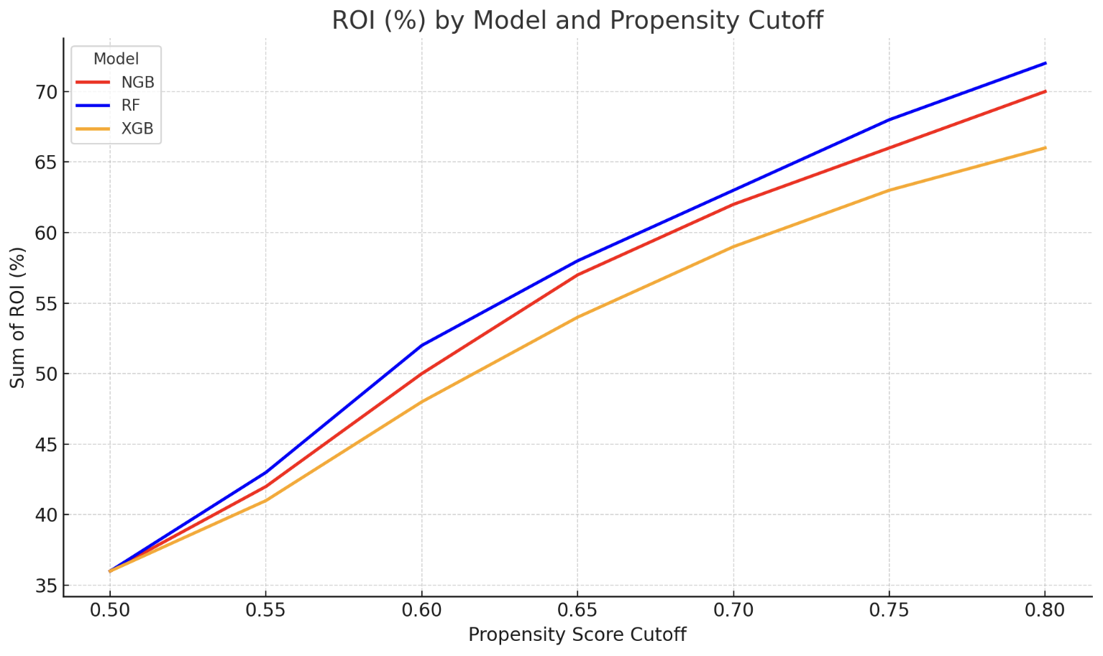
Relationship Between ROI and Propensity Cutoffs

Slide 18
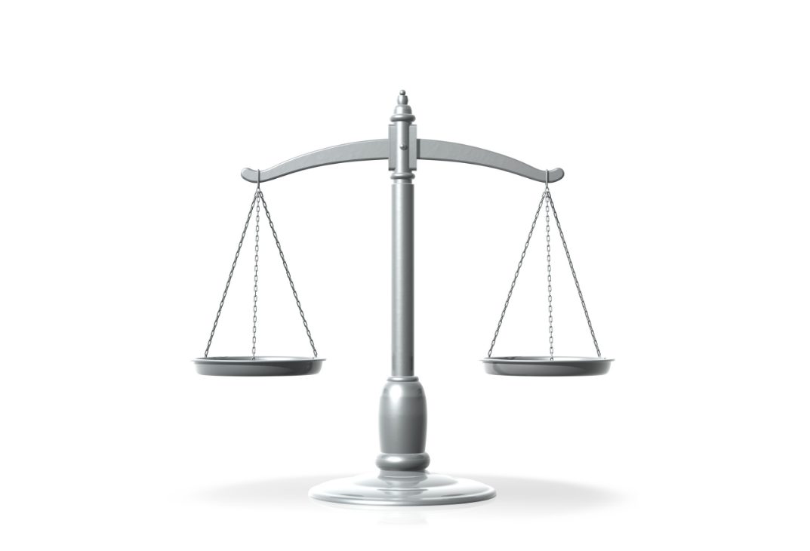
Findings
Best model from a prediction standpoint is NGBoost
NGBoost has higher accuracy by about .4% than other models
F1, Precision, and Recall are better than the 2 other models, indicating that the model is more balanced

Slide 19
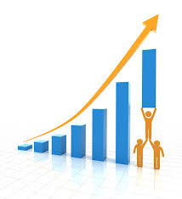
Findings
Based on ~10% of games bet, the best model is XGBoost from the perspective of ROI
XGBoost bet on 11.9% of games during the 2022-23, 2023-24, and 2024-25 seasons
ROI of of 65.73%, a 57.23% improvement on ROI from previous research
There is inefficiency in the NHL betting markets

Slide 20

What Factors Led to This Improvement?
Models used in the process having a greater ability to model non-linear relationships in data.
More complex data was used, including more predictors and the use of moving averages - 10x increase in number of predictors used overall prior to PCA.
Greater quantity of training and testing data, including not testing on the Covid season.
The use of 3-way moneyline bets rather than 2-way moneyline bets.

Slide 21
Is Implementation Feasible?
The use of 3 week Moving Averages make it impossible to bet on the first 3 games of the season
Data may not be updated everyday from MoneyPuck.com, which may make it difficult to bet on some games
Models used long term may have to be retrained to ensure accuracy

Slide 22
Conclusion
Significant positive ROI was seen over 3 seasons tested, including large improvements on 8.5% ROI
Data quantity and quality makes a significant impact on the accuracy of results
Machine learning can be used to elicit further inefficiencies in the NHL betting market

Slide 23

Thank You For Your Time!

Slide 24
Appendix
Duan, T., Avati, A., Ding, D. Y., Thai, K. K., Basu, S., Ng, A., & Schuler, A. (2020, June 9). NGBoost: Natural Gradient Boosting for Probabilistic Prediction. arXiv. https://arxiv.org/pdf/1910.03225
Kohers, G., Tuttle, M., & Bumpass, D. (2021, December 7). Examining NCAA/NFL market efficiency. Allied Academics. https://www.alliedacademies.org/articles/examining-ncaanfl-market-efficiency.pdf
Lev, A. (2019, December 19). XGBoost versus Random Forest. JFrog ML. https://www.qwak.com/post/xgboost-versus-random-forest
Luxton, C., Spizman, J., & Moore, D. (2022). Testing Efficiency in NHL Betting Markets. Digital Commons – Loyola Marymount University.
Na, S., Su, Y., & Kunkel, T. (2018, September 23). Do not bet on your favourite football team: The influence of fan identity-based biases and sport context knowledge on game prediction accuracy. European Sport Management Quarterly.

Slide 25
Appendix - Continued
Oswald, R. E. (2022). Testing the efficiency of the NFL betting market. University of Northern Iowa. https://scholarworks.uni.edu/cgi/viewcontent.cgi?article=1444&context=hpt/
Ramsey, E. (2025, January 15). Analysis: How high can US sports betting hold really climb? Legal Sports Report. https://www.legalsportsreport.com/111012/analysis-2023-us-sports-betting-hold-trend/
RG (Ed.). (2025). U.S. Sports Betting Revenue 2025 – State-by-state market analysis. RG. https://rg.org/statistics/us
Remander, S. (2020). AI driven NHL predictions – Comparison of classification methods in predicting NHL game event outcomes. Aalto University. https://aaltodoc.aalto.fi/server/api/core/bitstreams/86ed8e36-759f-42e6-a4ee-a904275cf039/content
RubinBrown. (2019). Focus on gaming: One year since the overruled Professional and Amateur Sports Protection Act. https://www.rubinbrown.com/insights-events/insight-articles/focus-on-gaming-one-year-since-the-overruled-professional-and-amateur-sports-protection-act/

